Slide 1
Representation of Words in NLP: A Historical Perspective
From Symbols to Contextualized Embeddings
Presented by:
Alex Astolfi
Filippo Momentè
Massimo Stefan
23-10-2023

Slide 2
Index
Introduction to NLP
1950s - early 1960s: The Dawn of NLP
Late 1960s - early 1980s: Transition to Structured Representation
Late 1980s - 2000s: Transitioning from Symbolic to Data-Driven Paradigms in NLP
2010s: The Era of Neural Embeddings
2020s: Advancements in Word Embedding Techniques and Interpretability
Recap and conclusions

Slide 3
Introduction to NLP

Slide 4





What is NLP?
Natural Language Understanding
Natural Language Generation
Speech or Voice recognition
Machine translation
Spelling correction and grammar checking
Is a subfield of Artificial Intelligence (AI) that focuses on the interaction between machines and human languages.

Slide 5



AI: The historical evolution
Symbolical
Statistical
Neural

Slide 6
1950s – early 1960s
The Dawn of NLP

Slide 7
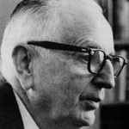
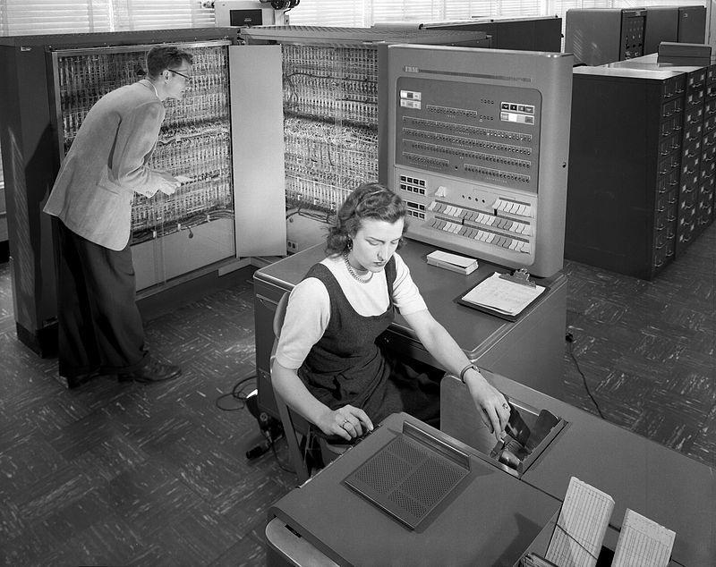
The Dawn of NLP
1949: Weaver's Memorandum on Machine Translation (MT)
1954: Georgetown-IBM Experiment
Warren Weaver's memorandum on Machine Translation marks the inception of NLP research, envisaging the potential of computers in translating languages.
The landmark Georgetown-IBM experiment showcases an English-Russian translation algorithm, translating 60 sentences using dictionary-lookup algorithms.

Slide 8
Late 1960s – early 1980s
Transition to Structured Representation

Slide 9
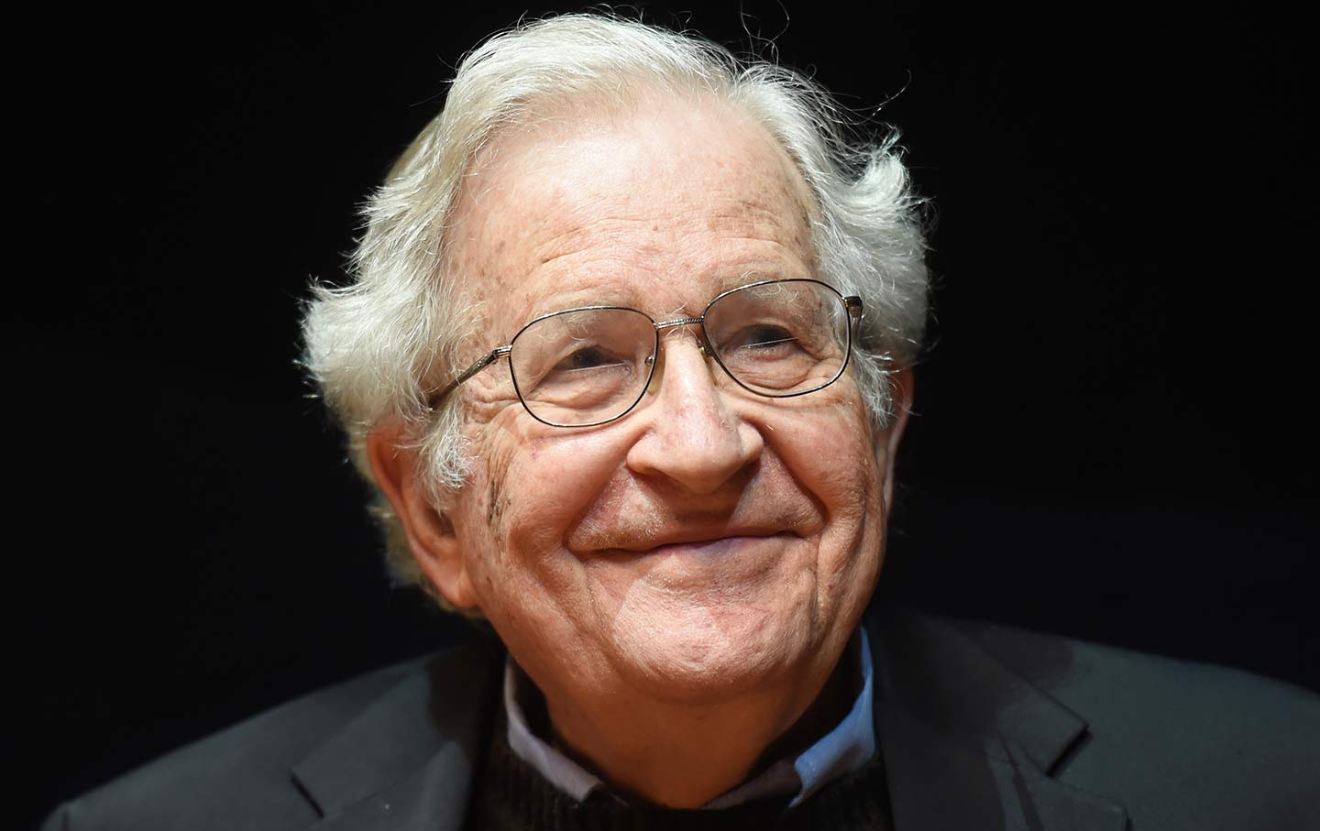
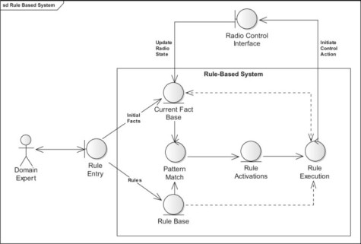
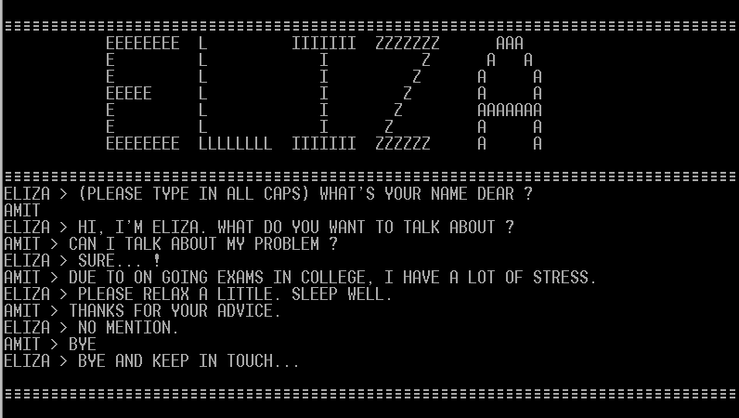
Late 60s: The Emergence of Rule-Based Systems
Noam Chomsky's introduction of generative grammars
Adoption of rule-based systems
ELIZA, simulated a Rogerian psychotherapist using rule-based techniques (1966)

Slide 10
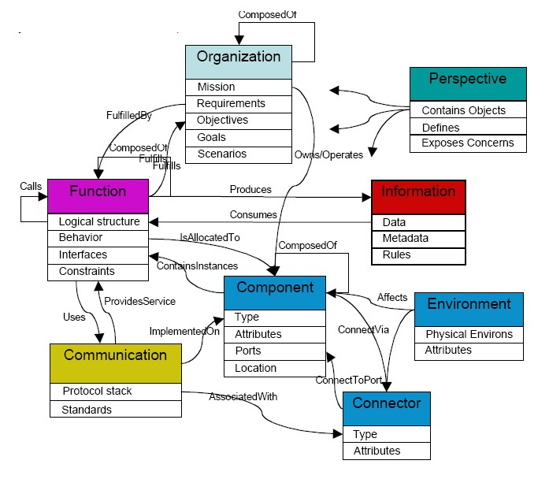

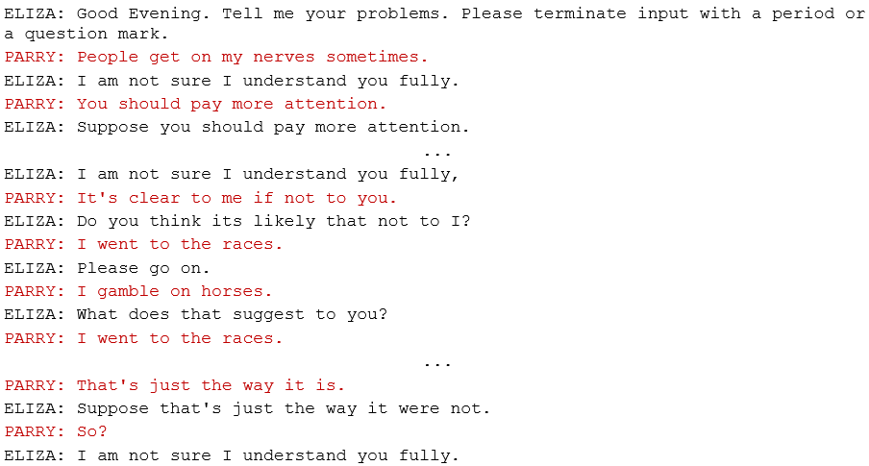
1970s: Conceptual Ontologies and Early Chatterbots
Birth of conceptual ontologies
Creation of early chatterbots
PARRY, simulate a person with paranoid schizophrenia (1972)

Slide 11

Early 1980s: Symbolic Approaches in NLP
Dominance of symbolic approaches:
Rule-based systems
Formal grammars
Parsing algorithms
Predicate logic

Slide 12
Word representation: Symbols
💡 Idea: Words are NOT represented through numbers but through strings of characters
✅ Pros:
Embeddings are highly interpretable
Explicit knowledge representation
Allow rule manipulation and customization
Easily incorporate domain-specific knowledge
❌ Cons:
Embedding are complex to create
Require high maintenance
Lack scalability to RW applications
Capture limited semantic information
Cannot effectively resolve ambiguities
🤔 When to use: can be applied on all tasks where explicit and interpretable rules are needed (parsing, basic MT, syntax checking, …) or simple well-defined non-scalable domains

Slide 13
Late 1980s - 2000s
Transitioning from Symbolic to Data-Driven Paradigms in NLP

Slide 14


Late 80s: Statistical language models
💡 Idea: Instead of writing rules, models handle language through probability distributions learnt from text data
⚡ Computational power ⚡
+
🔤 Chomskyan theories 🔤
=
📊 Statistical models 📊

Slide 15

1990s: Corpora Linguistics and Statical Approach
Rise of corpora linguistics and use of datasets
Success of statistical approaches in machine translation, but still limited amount of data
Introduction of supervised machine learning techniques.

Slide 16
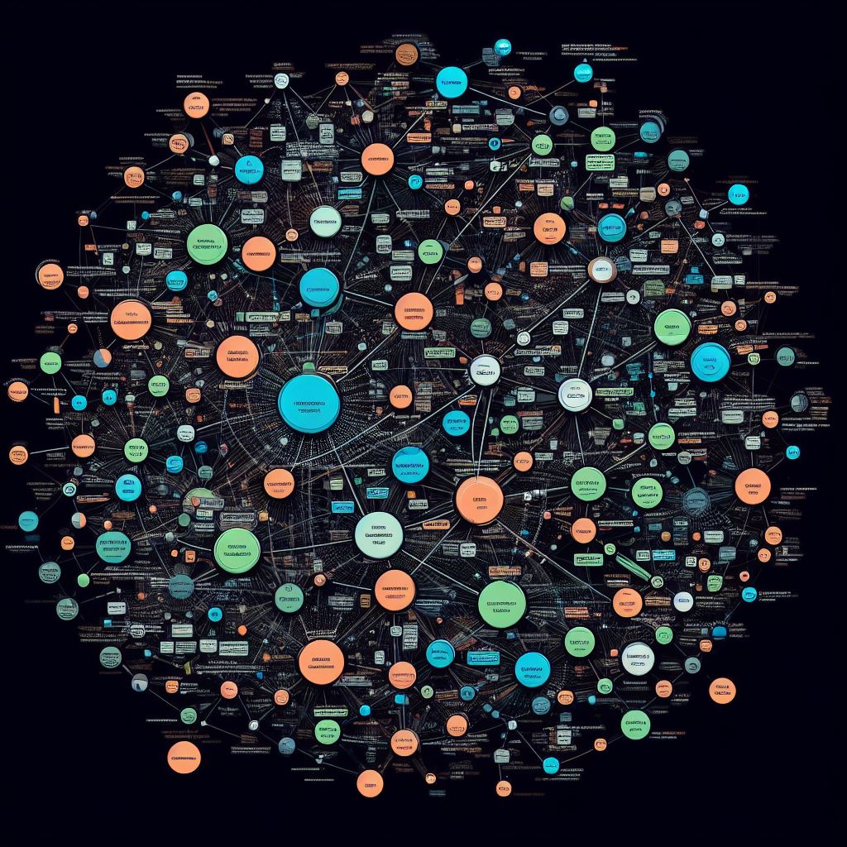
2000s: Treebanks and Early Machine Learning
Introduction of Penn Treebank and other annotated large corpora
New statistical parsing techniques
Research in semi-supervised/unsupervised learning

Slide 17
Word representation: Bag of words
💡 Idea: create a sorted vocabulary of all unique words present in the corpus and represent each word with a fixed length vector obtained based on counting frequency

Slide 18
Bag of words: One-hot encoding
💡 Idea: each word is represented by a vector of vocabulary length with all 0s, except for its position
📝 Example document: [“today I rained”, “today I ate pizza”]
📕 Vocabulary: [ate, I, it, pizza, rained, today]
🔣 Encoding of “ate”: [1,0,0,0,0,0]
🔣 Encoding of “pizza”: [0,0,0,1,0,0]
📄 Note: can be extended to sentences (based on words present or not)
🔣 Encoding of “today I ate pizza”: [1,1,0,1,0,1]

Slide 19
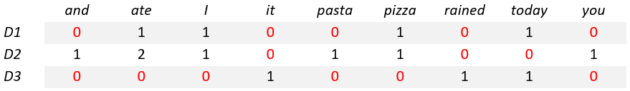
Bag of words: Count vector
💡 Idea: a matrix D*V represent the corpus, where:
D is the number of documents
V is the vocabulary length
📝 Example document 1: [“today I ate pizza”]
📝 Example document 2: [“I ate pizza and you ate pasta”]
📝 Example document 3: [“today it rained”]
📕 Vocabulary: [and, ate, I, it, pasta, pizza, rained, today, you]
🔣 Encoding of “I ate pizza and you ate pasta”: [1,2,1,0,1,1,0,0,1]

Slide 20

Bag of words: TF-IDF vectors
💡 Idea: produce representations which take into account the importance of a word across the document
📝 Example document 1: [“today I ate pizza”]
📝 Example document 2: [“I ate pizza and you ate pasta”]
📝 Example document 3: [“today it rained”]
📕 Vocabulary: [and, ate, I, it, pasta, pizza, rained, today, you]
Each entry of a matrix considers:
Term frequency (TF): how rare or common a term is in the words of the collection of documents
Inverse Document Frequency (IDF): how rare or common a term is in a collection of documents
These 2 numbers are then multiplied together.
📝 Example: (ate, D1)
TF = ¼
IDF = log($\frac{3}{2}$)
Entry (1,2) = ¼ * log($\frac{3}{2}$) $≈$ 0.044

Slide 21
Word representation: Bag of words
💡 Idea: create a sorted vocabulary of all unique words present in the corpus and represent each word with a fixed length vector obtained based on counting frequency
✅ Pros:
Encodings are simple and easy to implement
Sparse vectors (efficient storage)
Scalable
Do NOT require training (based on counting)
❌ Cons:
High dimensionality leading to overfitting
Fail to capture order and grammatical structure
Don’t yield any semantic information
Difficult to introduce OOV words
🤔 When to use: all downstream tasks which do not require structure or semantic understanding (classification, information retrieval, keyword extraction, …)

Slide 22
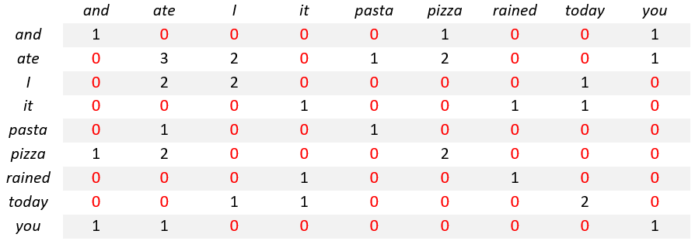
Word representation: Co-occurrences
💡 Idea: a V*V matrix where each entry corresponds to a couple of words and it is the number of times in which the two words occur together, within a fixed distance called context window
📝 Example document 1: [“today I ate pizza”]
📝 Example document 2: [“I ate pizza and you ate pasta”]
📝 Example document 3: [“today it rained”]
📕 Vocabulary: [and, ate, I, it, pasta, pizza, rained, today, you]
🪟 Context window: 2
📈 Co-occurrence (I, ate): 2
📈 Co-occurrence (end, ate): 0
📄 Note: can be reduced to a matrix V*N (removing function words) and its representation can be reduced by applying mathematical methods

Slide 23
Word representation: Co-occurrences
💡 Idea: a V*V matrix where each entry corresponds to a couple of words and it is the number of times in which the two words occur together, withing a fixed distance called context window
✅ Pros:
No training required
Low dimensionality
Can be used as features for ML algorithms
Capture semantic similarity
Introduce context understanding
❌ Cons:
Co-occurrences matrixes are large
Require memory to be stored
Decomposition can be computationally expensive
High influence of context window size
Word order not encoded
🤔 When to use: tasks where capturing semantic information and similarity between words is important (analogy, MT, …) or clustering tasks, word sense disambiguation, NER, …

Slide 24
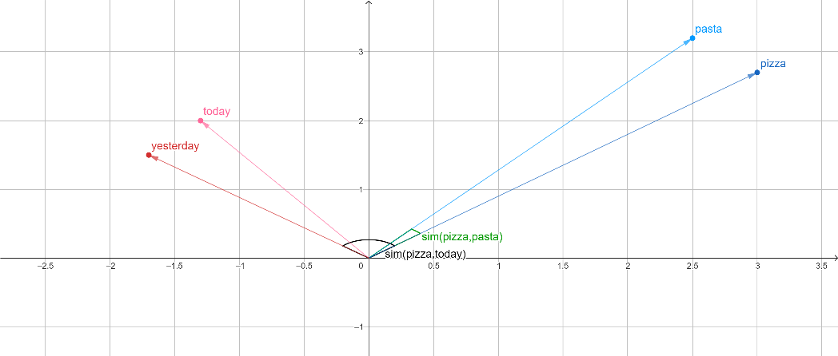
Excursus: vector spaces and cosine similarity
💡 Idea 1: represent each word with a point in an N-dimensional space, the vector corresponding to the word is an arrow from the origin of the axes to the point
💡 Idea 2: the cosine similarity is a measure of the angle between them and represent their similarity

Slide 25
2010s
The Era of Neural Embeddings

Slide 26
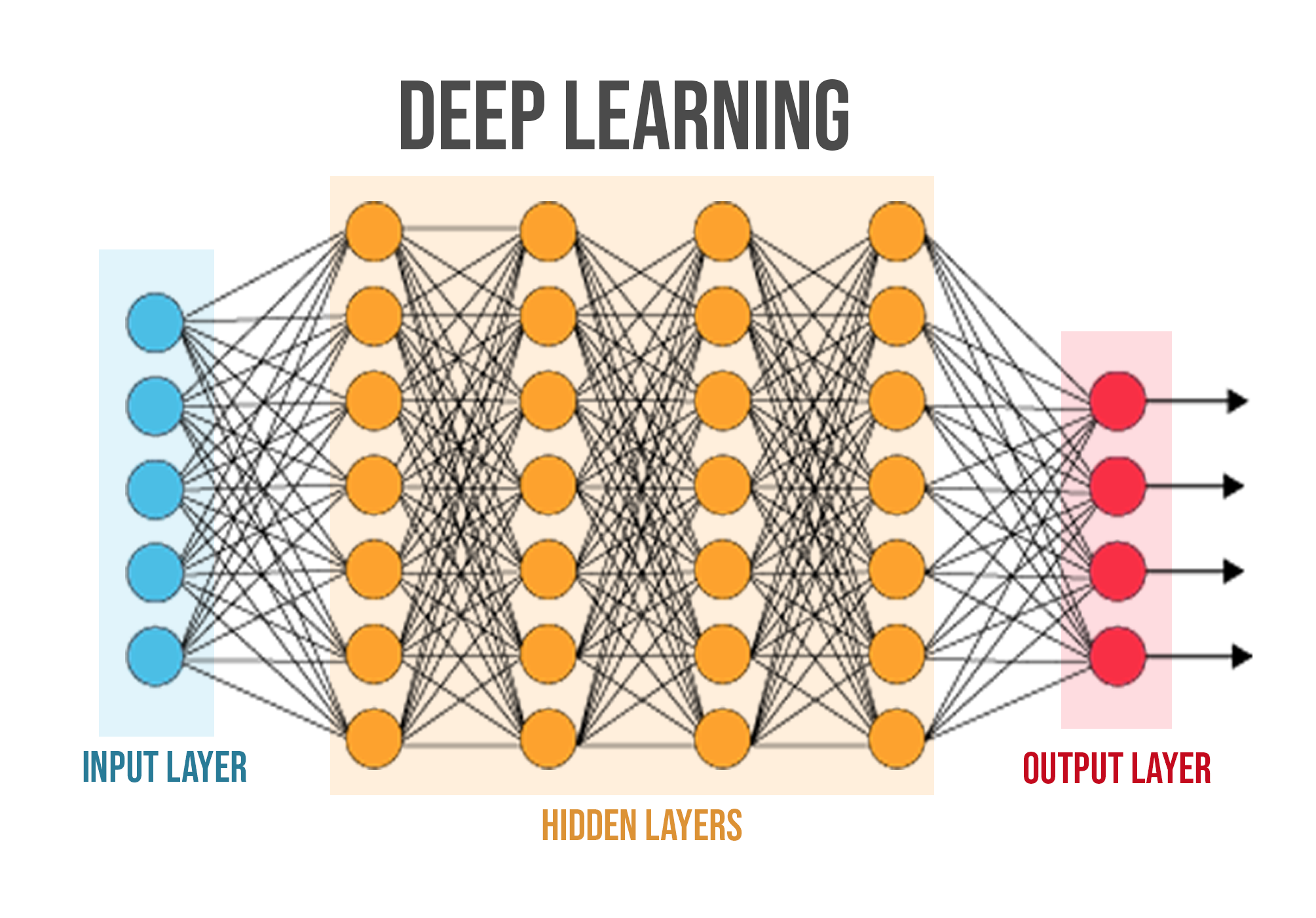
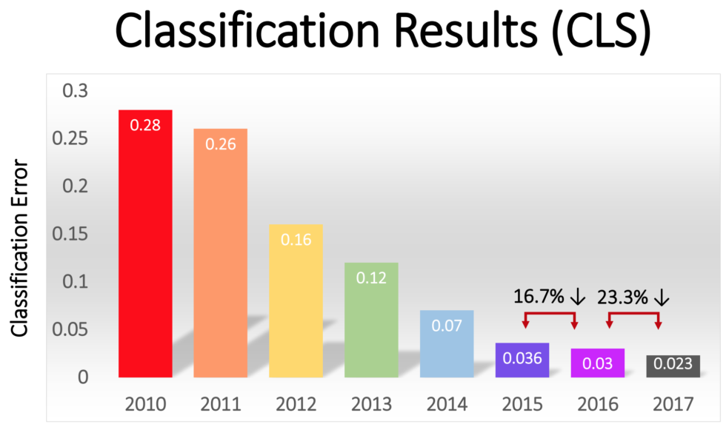
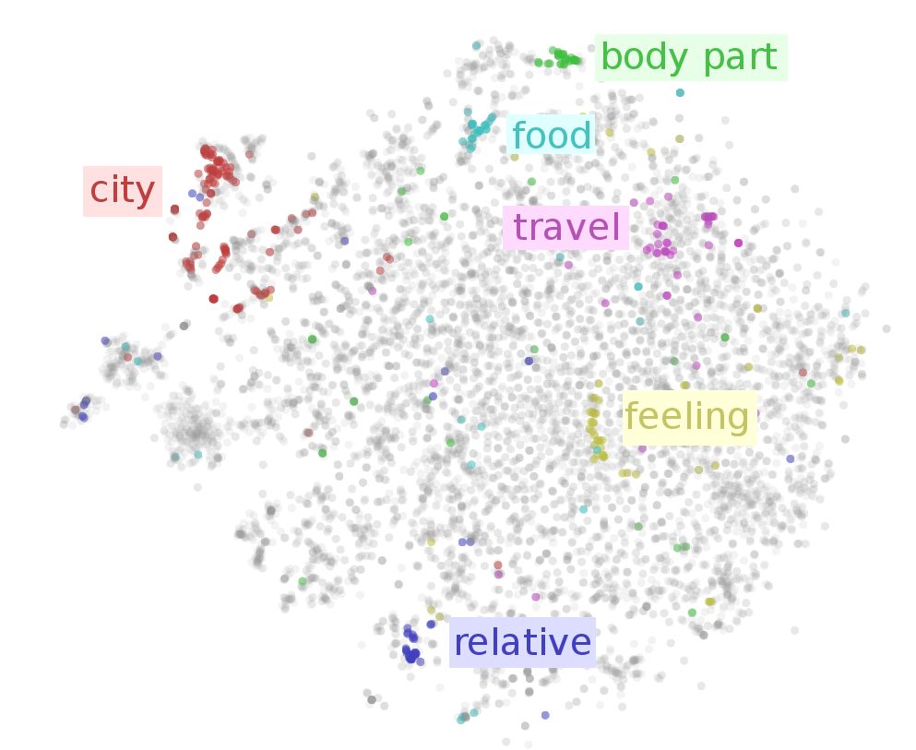
2010s: The Deep Learning Revolution in NLP
NNs are scaled up to multiple layers, the Deep Learning (DL) era begins
DL impact on the ImageNet challenge
Neural Embeddings can represent meaning, shift from counting to prediction

Slide 27
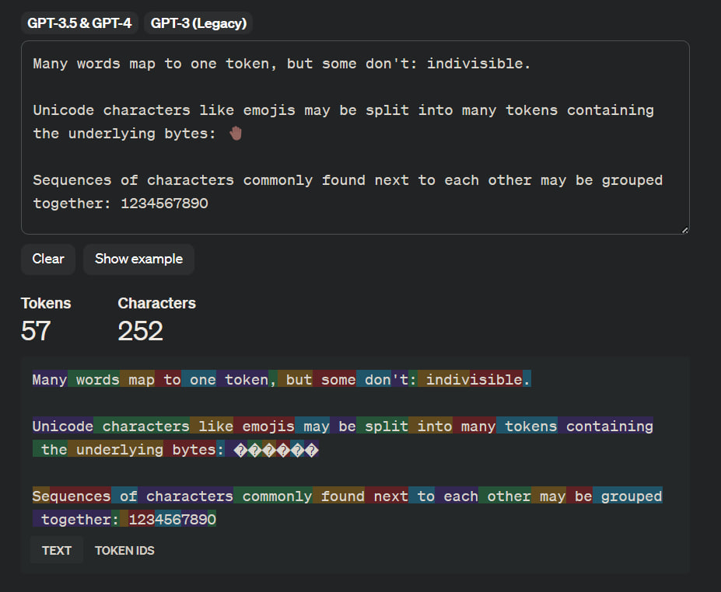
Tokenization
💡 Idea: break down a piece of text into smaller units, called tokens
🔥 Improvements: from word level to sub-word level the tokenizer can handle OOV words and work for multiple languages

Slide 28
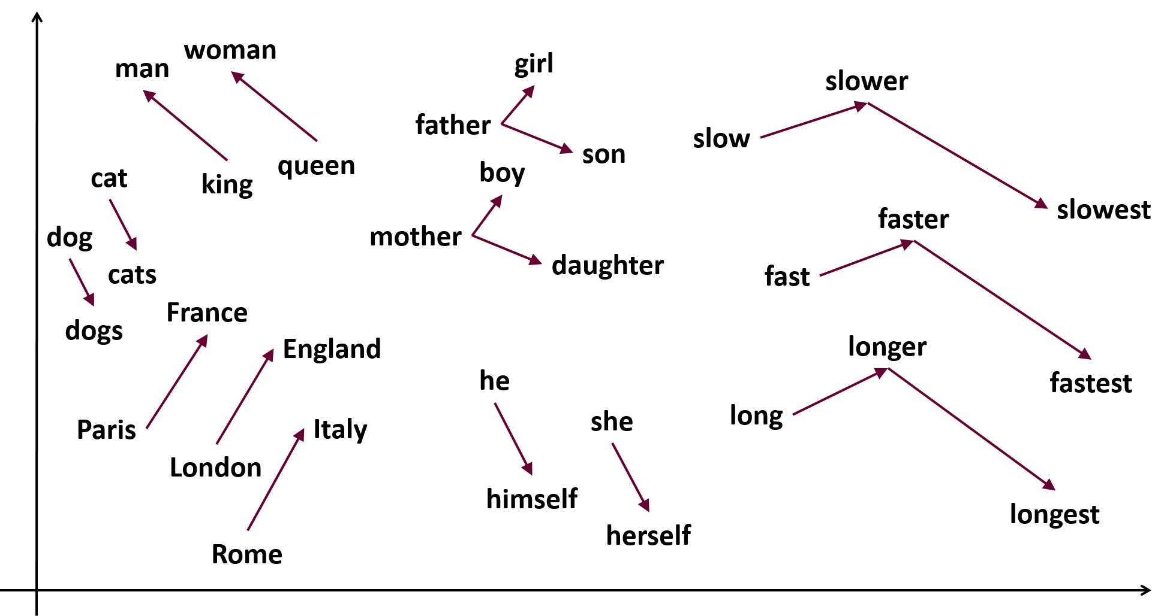
Word2Vec (2013): The First Strong Word Embedding Model
💡 Idea:
Train a classifier (self-supervised) to predict current or context words
Discard the classifier
Use the learned weights as word embeddings
🤖 Algorithms proposed:
CBOW: predict the current word given the context
SkipGram: predict the context words given the current word

Slide 29

Fasttext (2017): Leverage Sub-Word Embeddings
💡 Idea:
Learn representations for character n-grams
Represent words as the sum of the n-gram vector
🔥 Improvement: account for internal structure (e.g. “dog”, “dogs”, “dogcatcher”, …)
🔎 How: Each word is represented as a bag of character n-grams
📝 Example: word=“where” and n=3 => {“<wh”, “whe”, “her”, “ere”, “re>”, “<where>”}

Slide 30
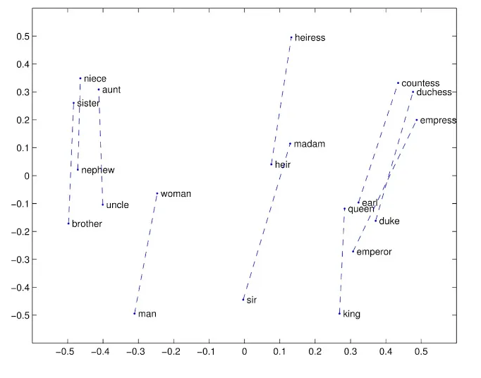
GloVe (2014): Leverage Co-occurrence matrix
💡 Idea:
Generate word embeddings by aggregating word-word co-occurrence matrix from a corpus
The resulting embeddings show interesting linear substructures of the word in vector space

Slide 31
Word representation: Static embeddings
💡 Idea: are generated by training a model on a large corpus of text and learning
the distributional properties of words
✅ Pros:
Really high accuracy compared to previous models
More interpretable than contextualized (see later)
Are stable and fixed regardless of the context
❌ Cons:
Do not capture the context
Are less expressive than contextualized embeddings
Ambiguous words (polysemy, ambiguity, homonymy) are not fully represented
🤔 When to use: task-specific data or baseline for downstream tasks (transfer learning) or tasks where semantic change and ambiguity are not present

Slide 32
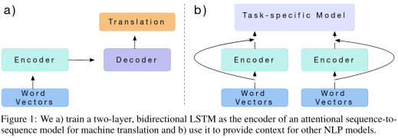
CoVe (2017): Leverage Bi-directional LSTM
💡 Idea:
Start from GloVe representations
Train an LSTM model for Machine Translation
📄 Note: can be used for transfer learning concatenating its representation to the corresponding GloVe representations

Slide 33
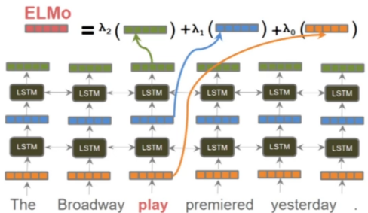
ELMo (2018): Combine different embeddings from LSTMs
💡 Idea:
Start from word vectors computed via char-CNN
Values go through 2-layer bidirectional LSTM
The final embedding is a task-specific weighting of all the layer outputs

Slide 34

The attention and self-attention mechanisms
💡 Idea: focus on specific parts of the input sequences, assigning a weight to each word
But:
Attention is used to attend to different parts of another sequence when making predictions generating another sentence
Self-attention is used to attend to different parts of the input sequence when making predictions (refers to the same sequence which is currently being embedded)

Slide 35
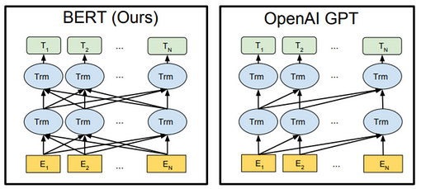
BERT vs GPT (2018): Transformer-Based Architectures
BERT
GPT
Trained on Masked Language Modeling (MLM), where some tokens are randomly masked and the model is trained to predict the original value based on the context
Use bidirectional flow, which allows it to use context from both directions during processing
Trained on Causal Language Modeling (CLM), where the model is trained to predict the next token in a sequence given all previous tokens
Use unidirectional flow, which allows it to use only the context from the previous tokens

Slide 36
Word representation: Contextualized embeddings
💡 Idea: are generated by considering the context in which words are present
✅ Pros:
Capture the meaning of words in context
Can handle polysemy, ambiguity, homonymy, …
Can be easily used for transfer learning
❌ Cons:
Computationally expensive to generate
Require large amounts of training data
May work worse than static embeddings when context is not important
🤔 When to use: tasks where a deep understanding of nuances and context-specific differences is essential

Slide 37
2020s
Advancements in Word Embedding Techniques and Interpretability

Slide 38
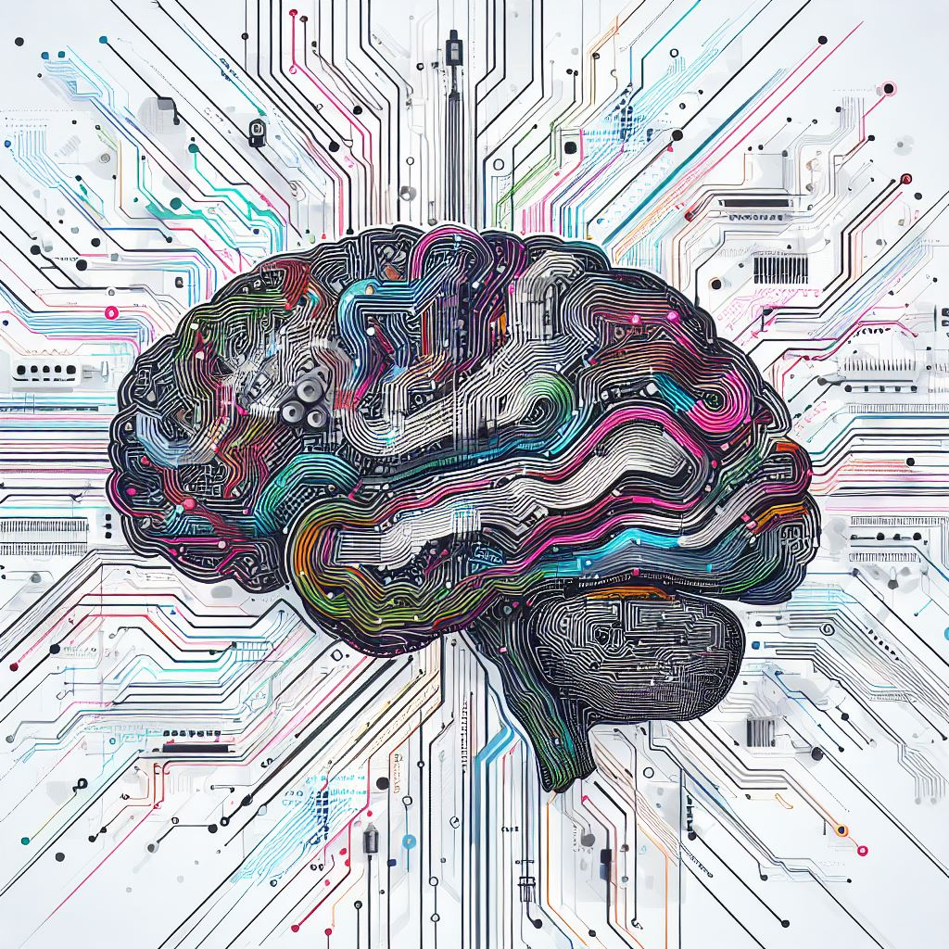

2020s: Current lines of research
Neurosymbolic approaches
Multimodal embeddings
Neural strategies + Older symbolic representations
Textual information + Visual information + …
🔥 Improvement: higher interpretability and generalization capabilities
🔥 Improvement: enhance the contextualization of the textual embeddings

Slide 39
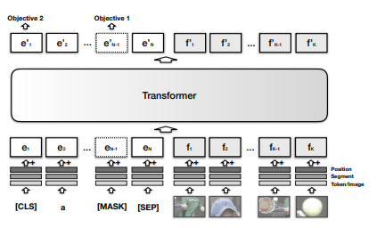
VisualBERT (2020)
💡 Idea:
Obtain output from BERT and from an object detector
Combine them together
Pass the result through a transformer to learn alignment
Take the output as embedding

Slide 40
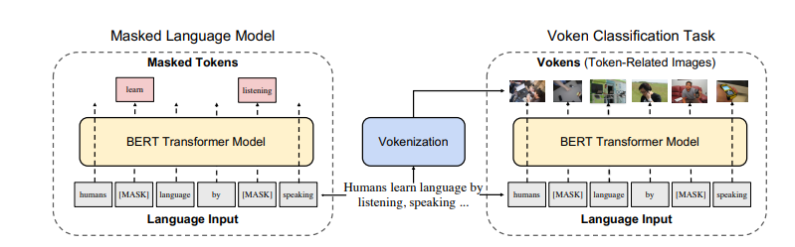
Vokenization (2020)
💡 Idea:
Split images into vokens: token-related subparts
Train a BERT model on Masked Language Modeling and Voken Classification
Take final output as embeddings

Slide 41
Word representation: Multimodal embeddings
💡 Idea: are generated by considering other modalities (images, video, audio, …) to enhance their meaning
✅ Pros:
Better performance (usually)
Can handle multimodal data
Via transfer learning can be fine-tuned for other tasks
❌ Cons:
Really computationally expensive
Require a huge amount of (coherent) data between modalities
May not work well on abstract concepts
🤔 When to use: when we have coherent data from multiple sources available (and a lot of computational power)

Slide 42
Recap

Slide 43






Word representation: Comparisons
Symbolic representations
Statistical representations:
Bag of words
Statistical representations:
Co-occurrence matrixes
Neural representations:
Static
Neural representations:
Contextualized
Neural representations:
Multimodal

Slide 44
References
https://www.samyzaf.com/ML/nlp/nlp.html https://arxiv.org/pdf/1607.04606.pdf (Fasttext) https://aclanthology.org/D14-1162/ (GloVe) https://medium.com/analytics-vidhya/word-vectorization-using-glove-76919685ee0b http://ai.stanford.edu/blog/contextual/ https://arxiv.org/pdf/1708.00107.pdf (CoVe) https://arxiv.org/pdf/1802.05365.pdf (ELMo) https://arxiv.org/pdf/1810.04805.pdf (BERT) https://s3-us-west-2.amazonaws.com/openai-assets/research-covers/language-unsupervised/language_understanding_paper.pdf (GPT) Embed2Sym - Scalable Neuro-Symbolic Reasoning via Clustered Embeddings (kr.org) (Emb2Sym) 1908.03557.pdf (arxiv.org) (VisualBERT) arxiv.org/pdf/2010.06775.pdf (Vokenization) https://www.icts.res.in/sites/default/files/media/media-library/NLPIntro.pdf (historical overview) https://medium.com/@antoine.louis/a-brief-history-of-natural-language-processing-part-1-ffbcb937ebce (historical overview) https://aclanthology.org/www.mt-archive.info/90/MTNI-1999-Hutchins.pdf (Weaver’s memorandum) https://aclanthology.org/www.mt-archive.info/Garvin-1967.pdf (Georgetown experiment) https://dl.acm.org/doi/pdf/10.1145/365153.365168 (ELIZA) https://www.cambridge.org/core/journals/behavioral-and-brain-sciences/article/abs/on-the-generality-of-parry-colbys-paranoia-model/CAEAAACBB8894DF9BB0ABC7CD7519D7C# (PARRY) https://www.rfc-editor.org/rfc/rfc439.html (Eliza-Parry conversation) https://www.analyticsvidhya.com/blog/2017/06/word-embeddings-count-word2veec/ (statistical word representation) https://arxiv.org/abs/1301.3781 (Word2Vec)

Slide 45
Thank You
Presented by:
Alex Astolfi
Filippo Momentè
Massimo Stefan

